Slide 1
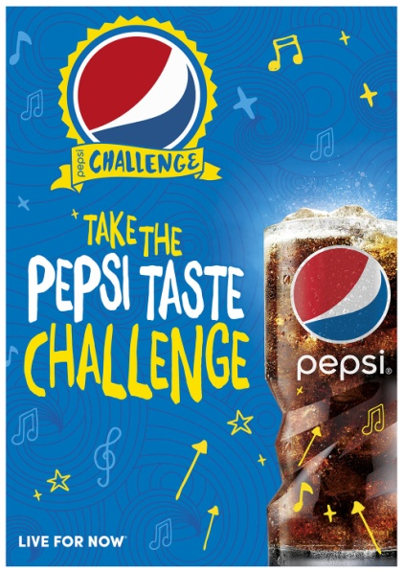
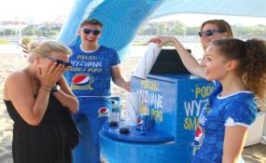
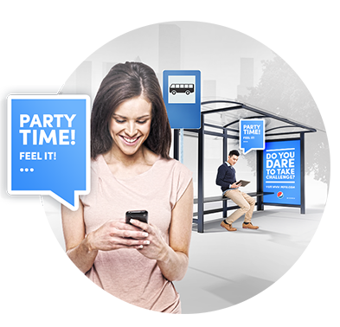
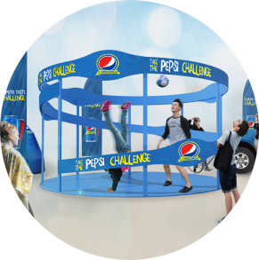

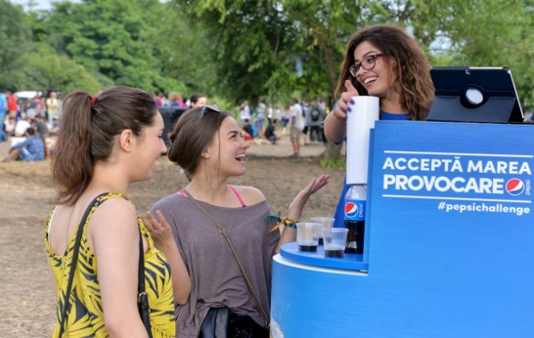
VIA DRIVING TASTE PERCEPTION ON REAL LIFE
TASTE CHALLENGE EVENTS
PEPSI TASTE CHALLENGE
ARENA CHALLENGE
DURING TASTE CHALLENGE EVENTS PARTICIPANTS CHOOSE THEIR PREFFERED DRINK & HAVE LOTS OF FUN
HEART OF THE CHALLENGE IS SPECIALLY DESIGNED ARENA: A PHOTOBOOTH (MADE FROM SEVERAL SMARTPHONES OR GO PRO CAMERAS). IT CAPTURES MOVING FROM 360 PERSPECTIVE.
ARENA’S ARE PLACED IN TASTE CHALLENGE EVENTS (POLAND & RUSSIA). PEOPLE CAN LOG IN TO THE ARENA APP VIA PEPSI WEBSITE & CREATE THEIR CHALLENGES FOR EVENTS PARTICIPANTS. CONSUMERS ON EVENTS PERFORM THE CHALLENGES IN ARENA. THEY RECEIVE A 360 VIDEO AND CREATORS OF BEST ARENA CHALLENGES ARE AWARDED.
PHASE 1.
DIGITAL
Co-Creation
PHASE 2.
EVENT
Realization
PHASE 3.
DIGITAL
Entertainment

Slide 2

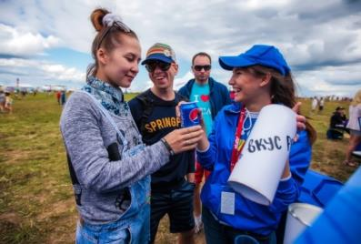
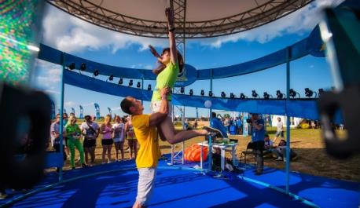
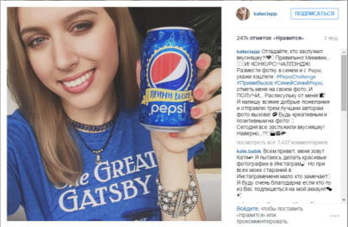
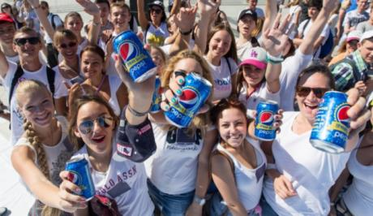
RUSSIA - 60% PEOPLE CHOOSE PEPSI
TASTE CHALLENGE:
PERIOD COVERED: 27.06 – 09.08
SM MEDIA REACH: 600M
PR IMPRESSIONS: OVER 3,5MM
EVENTS
NO. OF EVENTS: 8 BIG FESTIVALS
NO. OF PARTICIPANTS: 845 000
TASTING RESULT:
60 % PEOPLE CHOOSE PEPSI
ARENA CHALLENGE:
NUMBER OF SUBMISSIONS: 2414
APP SESSIONS: 1626
AVERAGE TIME SPENT IN APP: 1:53
COOPERATION WITH BLOGGERS
EARNED MEDIA IMPRESSIONS: OVER 4M
EARNED MEDIA VALUE: 400M USD

Slide 3

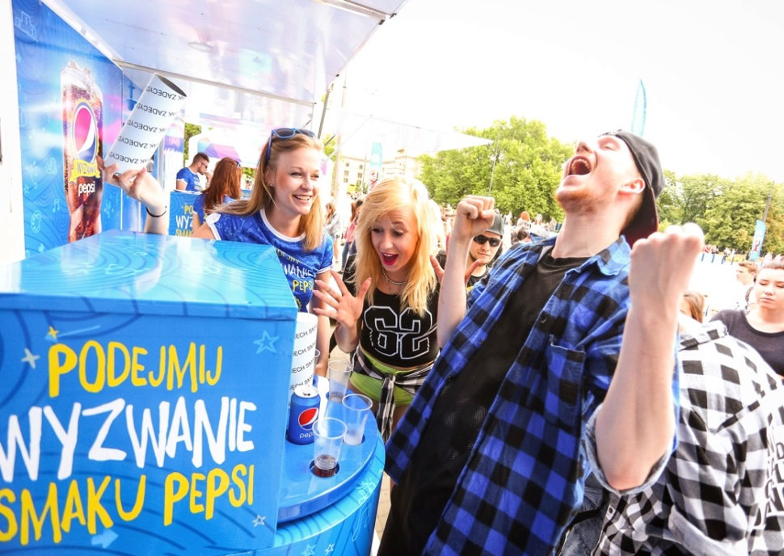
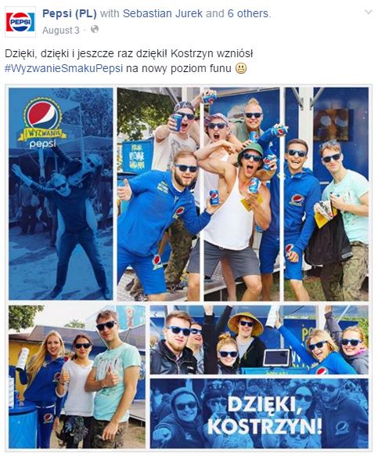
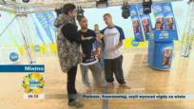
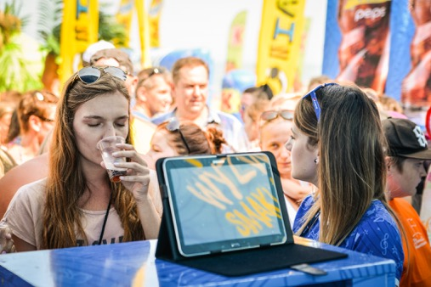

POLAND - 60% PEOPLE CHOOSE PEPSI
TASTE CHALLENGE:
PERIOD COVERED: 27.06 – 31.08
SM REACH: OVER 6MM
PR IMPRESSIONS: OVER 4MM
EVENTS
NO. OF EVENTS: 40 events
NO. OF PARTICIPANTS: 144 166
TASTING RESULT:
60% PEOPLE CHOOSE PEPSI
ARENA CHALLENGE:
NUMBER OF SUBMISSIONS: 2 575
APP SESSIONS: 38 356
AVERAGE TIME SPENT IN APP: 2:42
COOPERATION WITH MEDIA PARTNERS
EARNED MEDIA: OVER 30MM

Slide 4

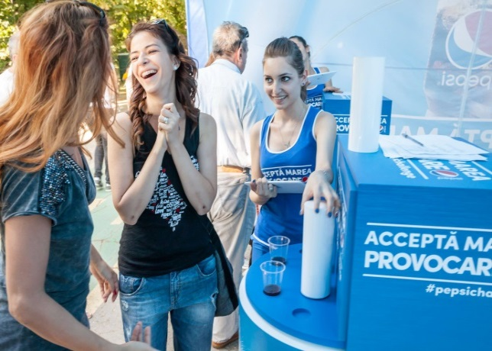
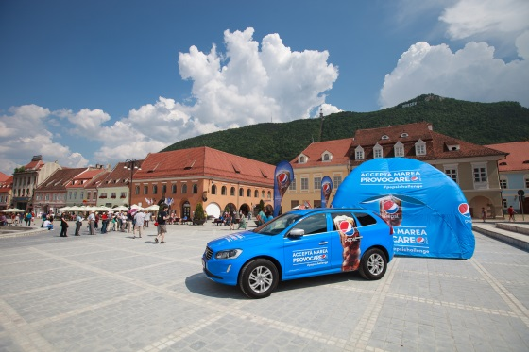
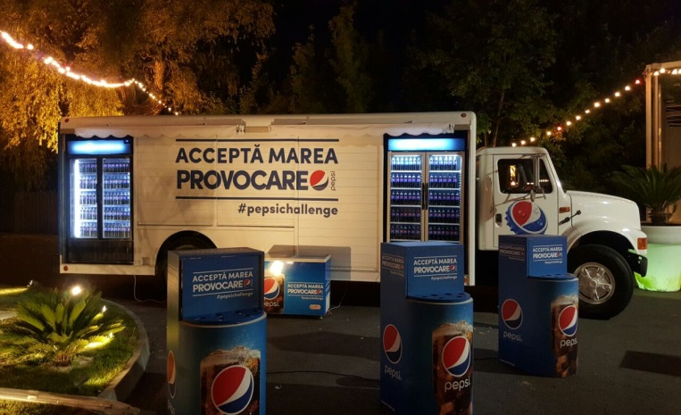

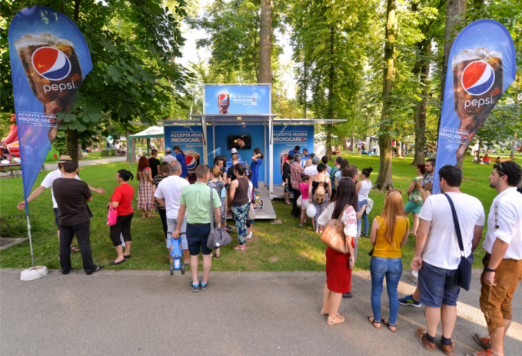
ROMANIA - 62% PEOPLE CHOOSE PEPSI
TASTE CHALLENGE:
PERIOD COVERED: 27.06 – 31.08
EVENTS
NO. OF EVENTS: 8 CITIES + SEASIDE
NO. OF PARTICIPANTS: 104 000
TASTING RESULT:
61,9 % PEOPLE CHOOSE PEPSI

Slide 5
TASTING SUCCESS IN EER
TASTE CHALLENGE EVALUATION:
WORKED WELL:
PEPSI CHALLENGE IS AN ATTRACTIVE CONCEPT TO ADDRESS SWITCHERS AND HELPS TO CLOSE IMAGE GAP TO CC
CHALLENGE ARENA HELPS TO LINK BTL EVENTS WITH ATL DIGITAL ACTIVITY AND BUILD ENGAGEMENT VIA ULTIMATE EXPERIENCE
EVENTS ARE A GOOD PLACE TO CREATE HIGH QUALITY ALWAYS-ON DIGITAL CONTENT
THANK YOU PHASE HELPED TO ESTABLISH ‚PEPSI HAS A BETTER TASTE’ IN CONSUMERS MINDS
ON TIME EER TOOLKIT DELIVERY AND CLOSE COOPERATION WITH MARKETS CONTRIBUTED TO TIMELY EXECUTION WITH HIGH QUALITY LOCALIZED ASSETS
MIXED:
TASTE CHALLENGE TVC DID NOT COMMUNICATE TASTE CHALLENGE EVENTS
NO CENTRAL SS DRIVE PLATFORM THAT WOULD HELP TO CLOSE THE DEAL INSTORE
(RUSSIA, ROMANIA) DIGITAL CONTENT NOT ALWAYS OF HIGH QUALITY LOWERING DIGITAL ENGAGEMENT
ISSUES IN CHANGING THE FORMULA CAUSED DELAYS
CONCLUSIONS:
TASTE CHALLENGE AS AN ATTRACTIVE CONCEPT HELPING TO BUILD SOM AND RMS AND CLOSE GAPS TO CC ON KPIs
EVENTS AND SPECIAL ATTRACTIONS (PEPSI ARENA) SHOULD BE USED TO CREAATE BEST ALWAYS-ON DIGITAL CONTENT
TASTE CHALLENGE CAMPAIGN SHOULD END UP WITH THANK YOU PHASE TO ESTABLISH ‚PEPSI HAS A BETTER TASTE’ IN PEOPLE’S MINDS
TVC SHOULD COMMUNICATE CHALLENGE AND INVITE TO EVENTS
TASTE CHALLENGE PLATFORM SHOULD BE ACCOMPANIATED WITH SS DRIVE MECHANISM TO CLOSE THE DEAL INSTORE

